Slide 1
Acumen Business
Rule Manager
A Graphical
Business Rules Environment
For RuleML
10-25-2007

Slide 2
Our Mission Statement
Rule based systems that can be maintained by business users (not programmers)
10-25-2007

Slide 3
Acumen Business
Product History (1/2)
Vocabulary Upgrader
  BizTalk Vocabulary Management
Policy Verificator 1.0.x
  Rule Verification for BizTalk 2004
Policy Verificator 1.2.x
  Rule Dependency Graph
Policy Verificator 1.3.x
  Business Rule Editors [Read-only]
  Interactive Rule Map
  Html Rule Documentation
10-25-2007

Slide 4
Acumen Business
Product History (2/2)
Rule Manager 1.4.x
  Support BizTalk 2006
  Text Search
  PDF Rule Documentation
Rule Manager 1.5.x
  Support Windows Workflow Foundation
  Vocabulary Management
  Restrictive Rule Editing
  Rule Validation
10-25-2007

Slide 5
Overview of Demo
Create a mortgage approval system
  Open an existing rule policy
  Show Rule Documentation
  Discover Rule Anomalies
  Edit Rules & Create Rules
  Export rules
    to Windows Workflow Foundation
10-25-2007

Slide 6
Adapter Components
Business Rule Editors
BizTalk
Rule Animation
Windows Workflow
Foundation
Rule Documentation
Rule Validation
RuleML
Rule Verification
Acumen Internal Model
Rule Repository
10-25-2007
Notes:
All rule formats are pretty similar. We developed a simple adapter interface to import and export into our model.

Slide 7
Rule Editor Features
Business friendly term names
Intelligent type conversions
Term lookup suggestions
Operator insertion
  ‘>’ key inserts ‘is greater than’ ...
Invalid expression mark
Edit time user input constraints
Restrictive editing
10-25-2007

Slide 8
Rule Verification
Detection of Self Anomalies and Rule Anomalies
  Contradictions
  Redundancies
  Tautologies
  Incompleteness
Easily visualized in
Rule Conflict Network graphs
10-25-2007

Slide 9
Rule Documentation and Animation
PDF Documentation includes
  Business Rules
  Rule Index
  Complete Rule Dependency Graph
Interactive Rule Graph explores the rule dependency network
Search and Filter for managing large rulesets
10-25-2007

Slide 10
Rule Validation
Rule Map (Cause-effect diagram) becomes a simulation of the actual rule execution.
Every term can be set as a goal
Test scenarios and expected outcomes can be saved for regression tests [next release]
10-25-2007

Slide 11
Import & Export
Export to Reaction RuleML format
Import and Export Windows Workflow Foundation rules
Restrictive editing allows hot deployment of rules into a production environment
10-25-2007

Slide 12
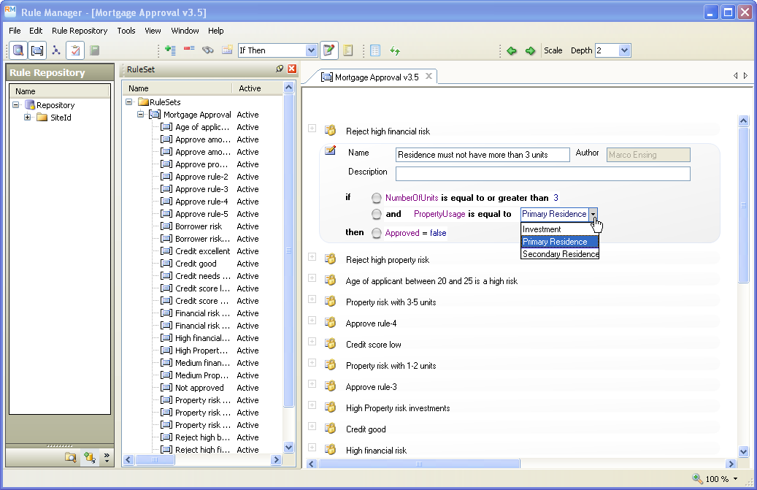
Rule Manager Demo
10-25-2007

Slide 13
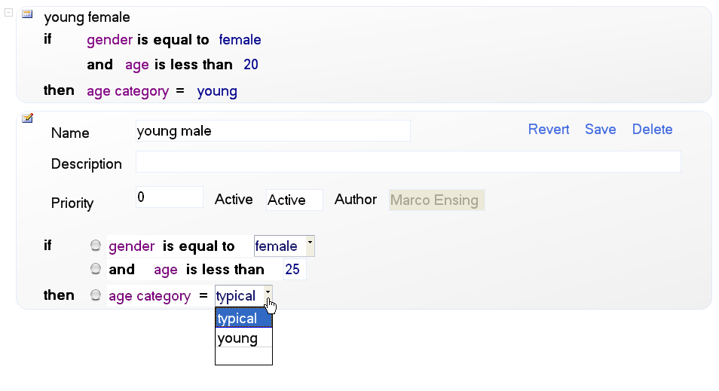
Rule Editing
10-25-2007

Slide 14
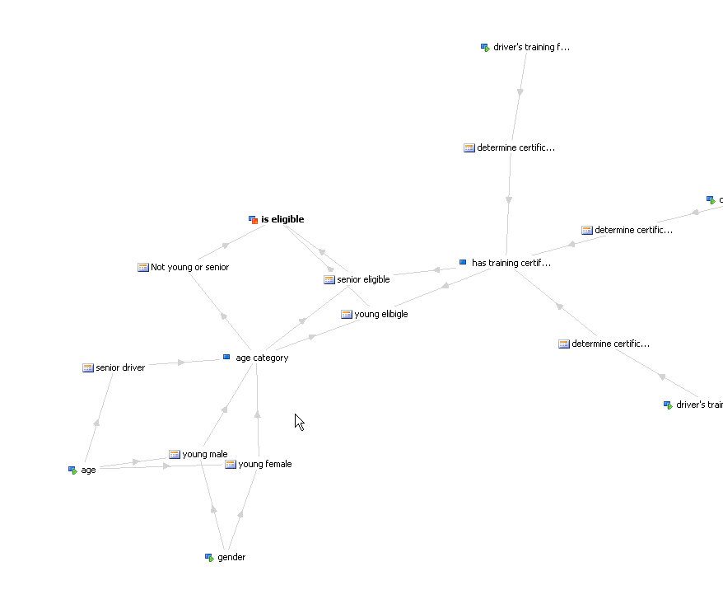
Cause - Effect Graph
10-25-2007

Slide 15
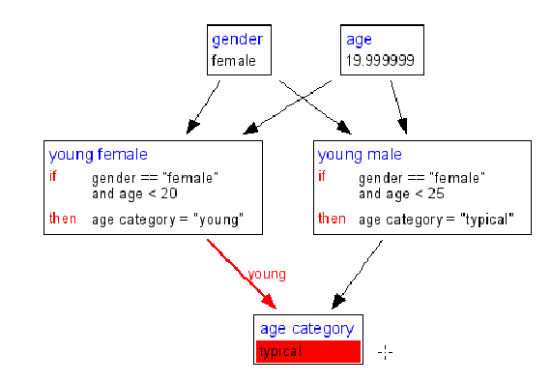
Rule Verification
10-25-2007

Slide 16
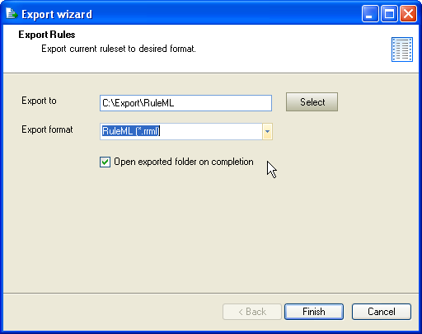
Export wizard
10-25-2007

Slide 17
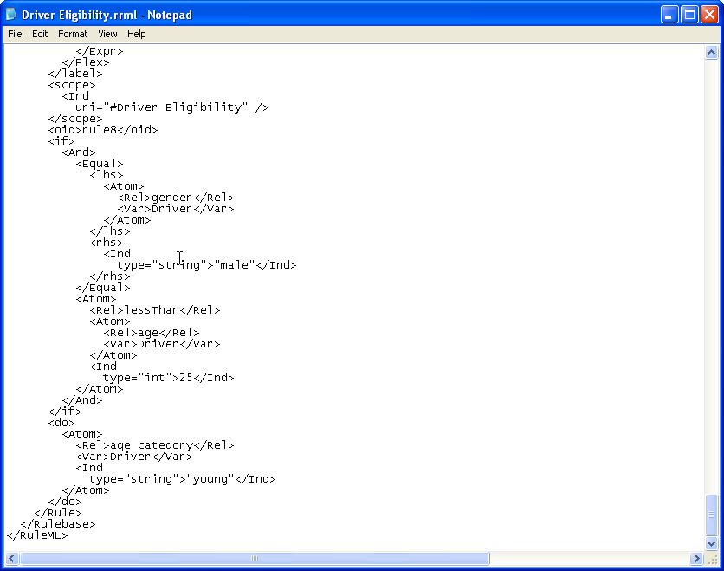
Export wizard
10-25-2007

Slide 18
About Acumen Business
For more information contact us at
info@acumenbusiness.com
Or visit our website at
www.acumenbusiness.com
10-25-2007

